Slide 1
Cyber Discovery 2.0
Investigative Session 1
Computer Networks

Slide 2
Your Laptops
Turn on your laptops
  Login username: cyber
  Login password: cyber
It looks a bit different, doesn't it?

Slide 3
Linux
Just another operating system like Windows
  Allows you to operate and interact with the computer
Important tidbits
  Desktop

Slide 4
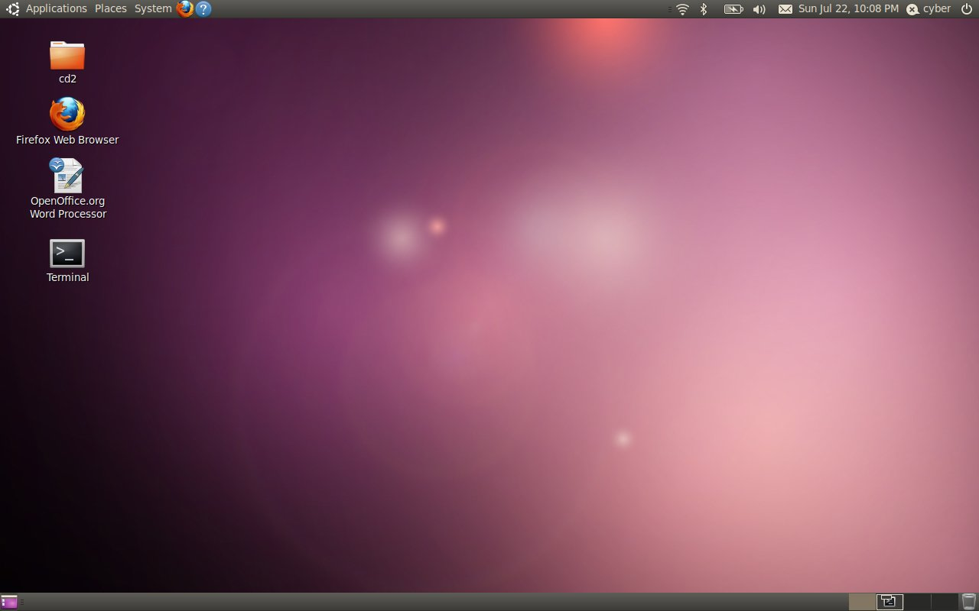
The Desktop

Slide 5
Linux
Just another operating system like Windows
  Allows you to operate and interact with the computer
Important tidbits
  Desktop
  Terminal
    Prompt
    Ctrl+D or exit
    Shift+PgUp, Shift+PgDn

Slide 6
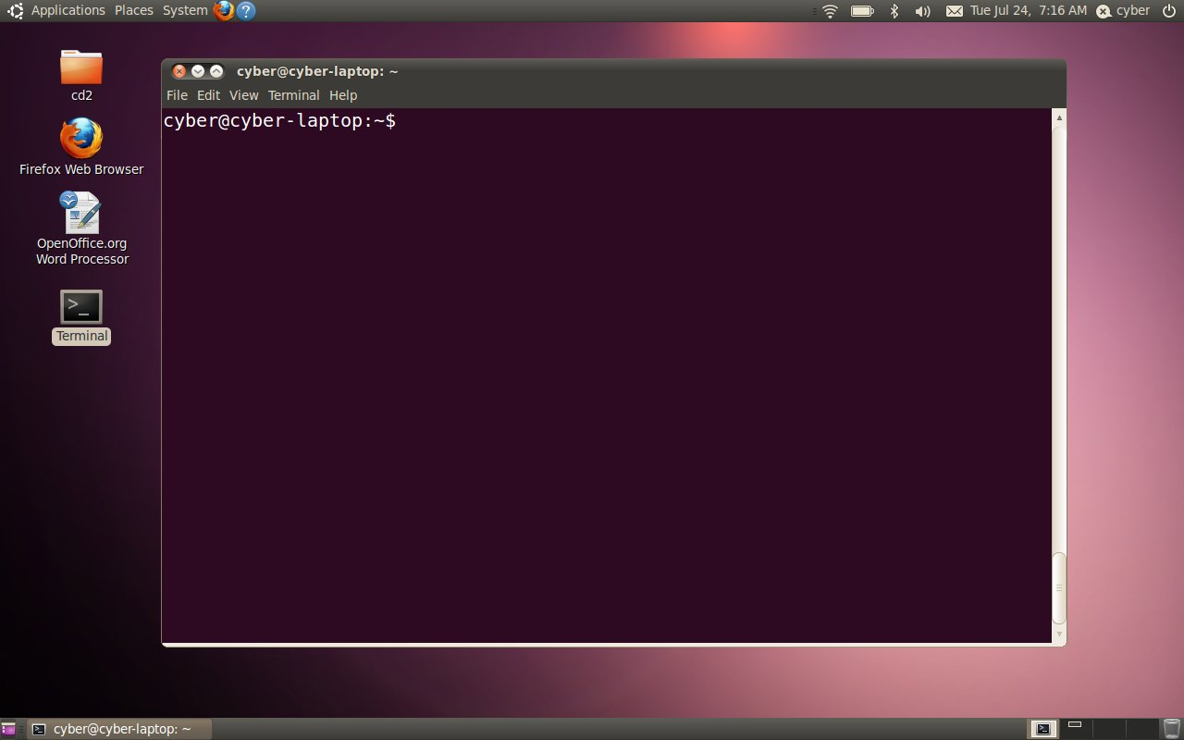
The Terminal

Slide 7
Linux
Important tidbits
  Executing a command/running an application
    clear
    ls
    ls -l
    . and ..
    man ls
    cd
    cyber

Slide 8
Linux
Important tidbits
  Case sensitivity
    cd desktop vs. cd Desktop
  Tab/Double Tab auto-completes while typing
  The root user
    sudo

Slide 9
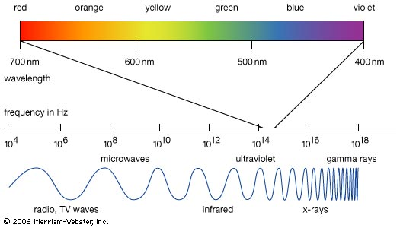
Cyberspace

Slide 10
Cyberspace
The domain in which digital information moves
Things that are a part of cyberspace
  Computer
  Laptop
  Network cable
  Cell phone
  Sensor on a buoy in the ocean

Slide 11


What is a Network?
A bunch of connected components
Components are called nodes
Connections are called links
node
node

Slide 12
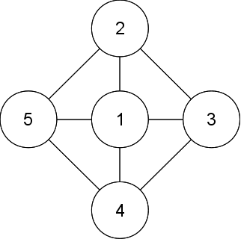
An Example Network
How is a message sent from node 1 to node 4?

Slide 13
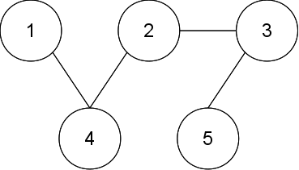
Sending a Message
How is a message sent from node 1 to node 5?

Slide 14
Routing
Nodes route messages to other nodes using a routing table
We can trace the route a message takes
  Traceroute
We can also ping a node to determine if it is connected to the network
  Ping
  The response is called a pong

Slide 15
Sending a Message
Ping
.
.
.
.
.
Pong
Traceroute:
1
4
2
3
5

Slide 16
Identifying Nodes
Nodes are identified by an IP address
IP addresses are made up of four sets of numbers that range from 0 to 255
  For example: 138.47.33.202
How many unique IP addresses are there?
  4,294,967,296
  256 x 256 x 256 x 256 = 256⁴
Is this enough?

Slide 17
Identifying Nodes
IPv6 improves upon IPv4 by increasing the address space
Now we have 8 sets of hexadecimal numbers that range from 0 to 65,535
  For example: 04a4:3bb6:f612:8c88:d399:560e:7ae1:e11e
How many unique IP addresses are there now?
  65,536⁸ = 3.4×10³⁸
  That's 3.4 undecillion

Slide 18
Messages
Messages are often too large to send in one shot
We split the message up into chunks called packets
Meet
me
at m
idni
ght
by t
he p
ark.
by t
me
ark.
ght
he p
at m
Meet
idni

Slide 19
Messages
Packets
Meet
Sequence
Number
1
Part of the Message
2
Meet
me
Meet
Source
IP Address
138.47.46.99
Meet
Meet
138.47.33.212
Destination
IP Address
Meet
me
at m
idni
ght
by t
he p
ark.

Slide 20

Fun with Strings

Slide 21
The Real World?
Nodes are machines
  Computer
  Laptop
  Cell phone
  Wii
  PlayStation
  Xbox
Links are network cable or wireless

Slide 22
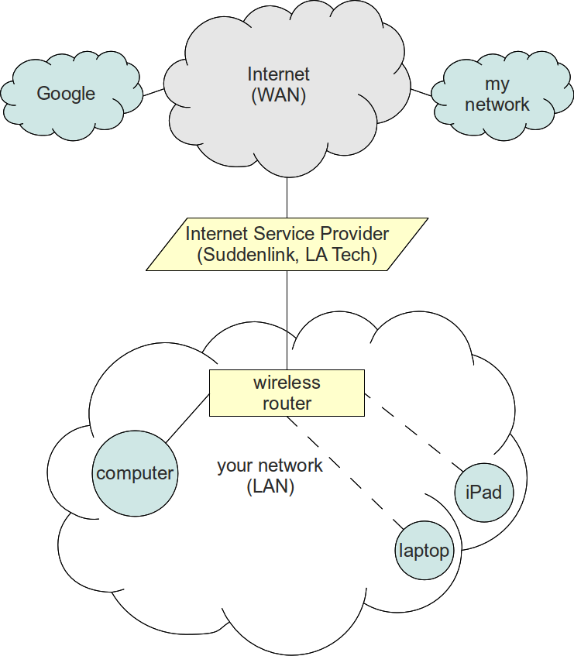
The Real World?

Slide 23
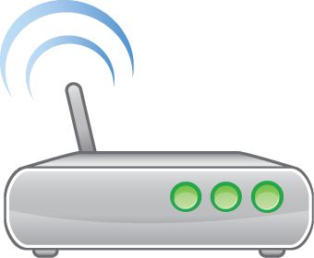
In Practice...
This
is a
table
:)

Slide 24
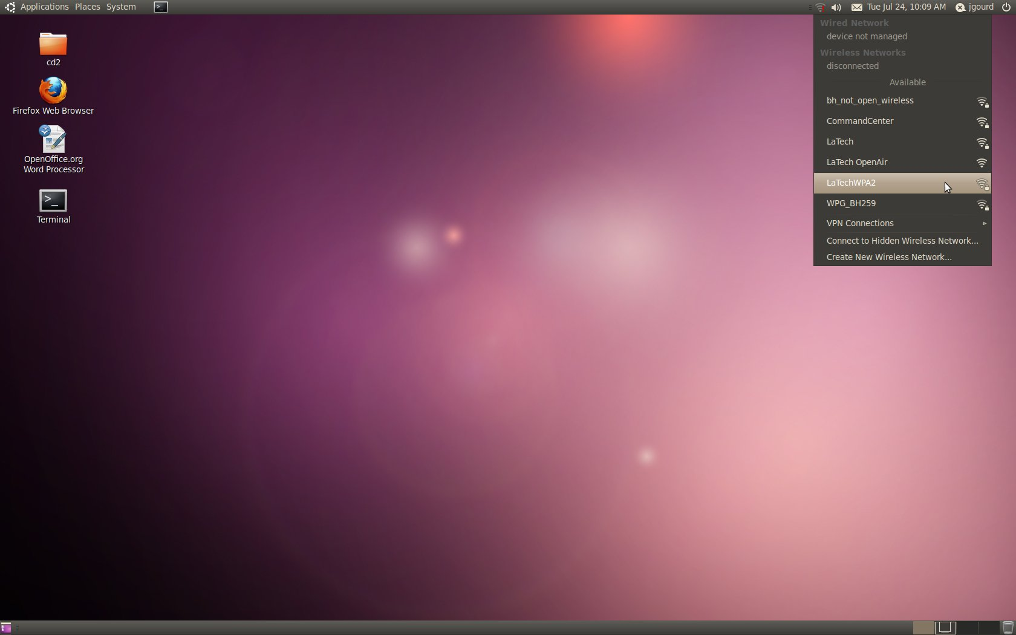
Getting on the Network

Slide 25
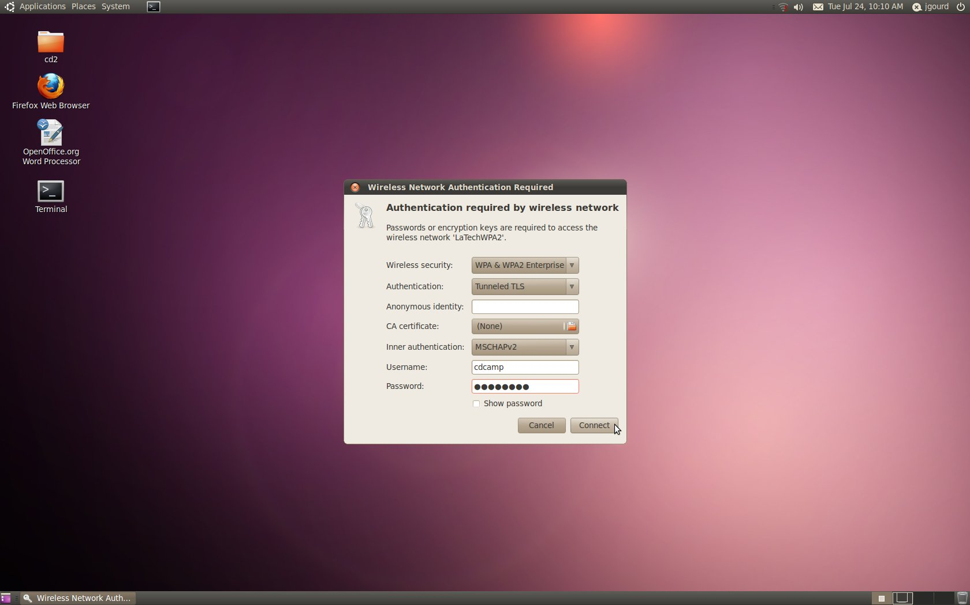
Getting on the Network

Slide 26
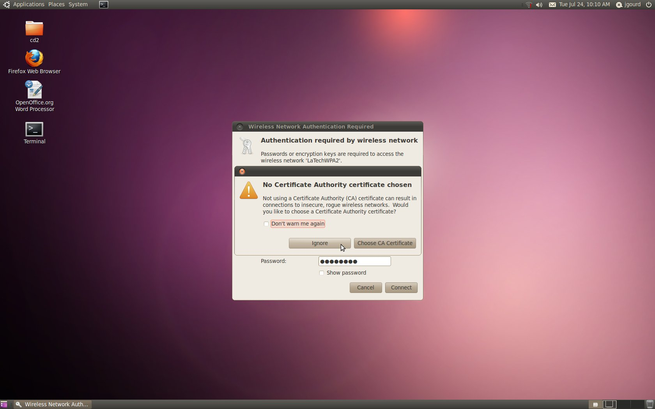

Slide 27
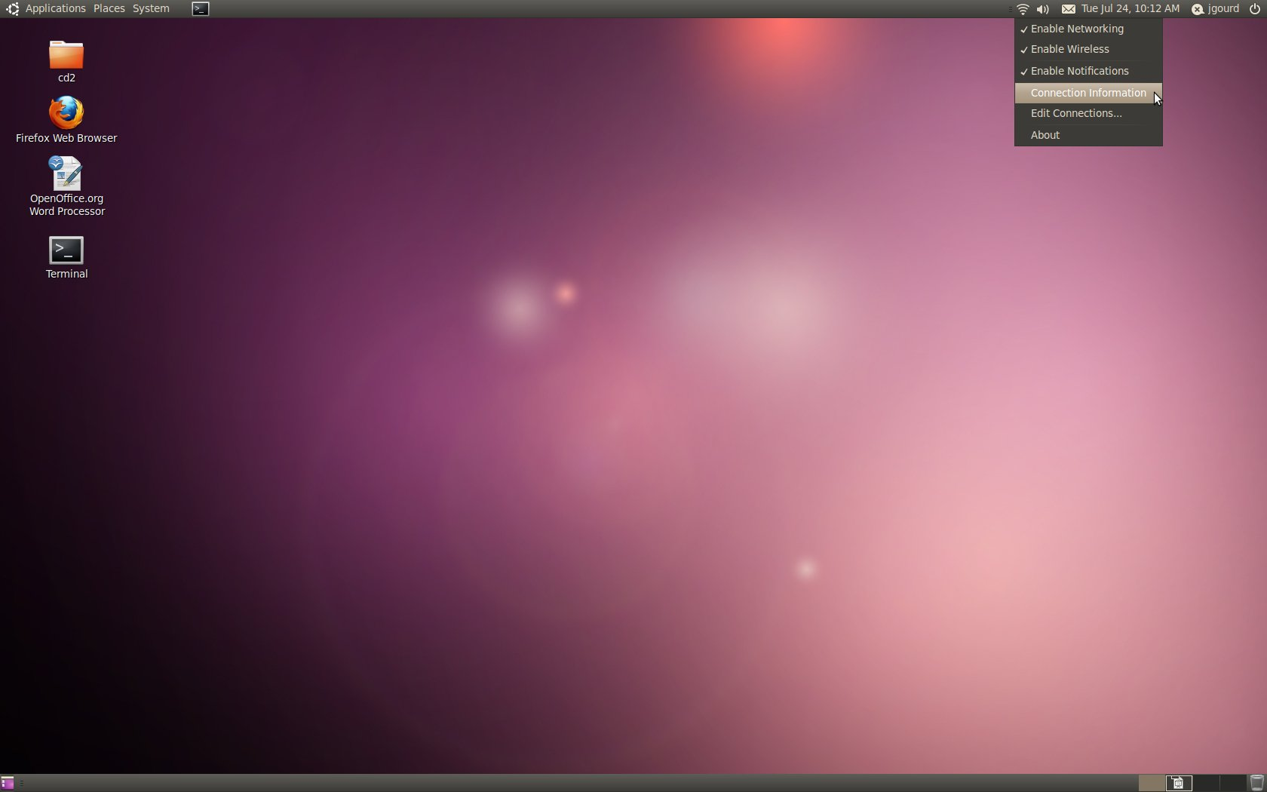
Connection Information

Slide 28
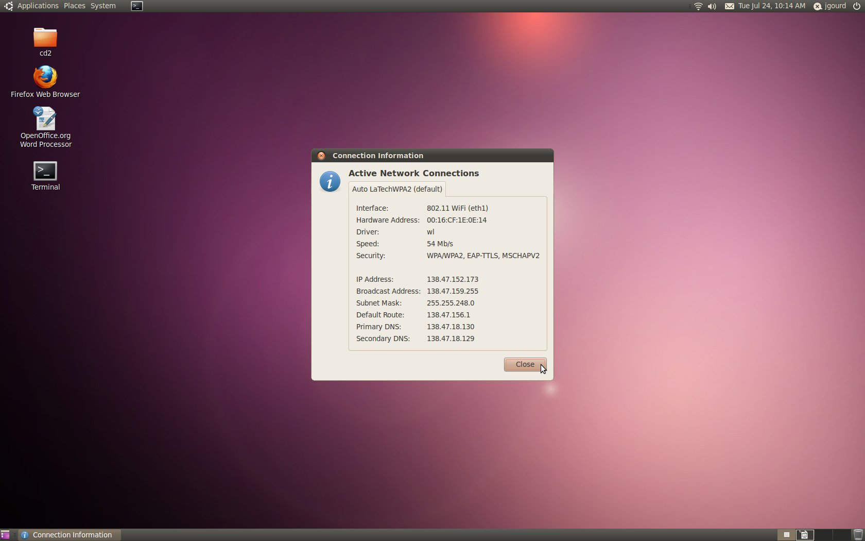
Connection Information

Slide 29
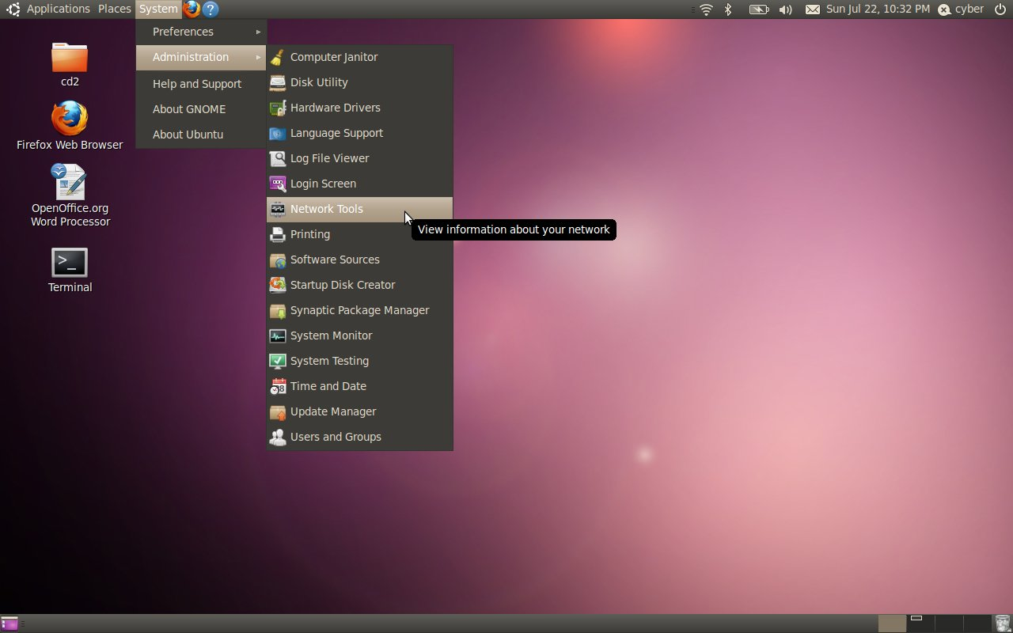
Network Tools

Slide 30
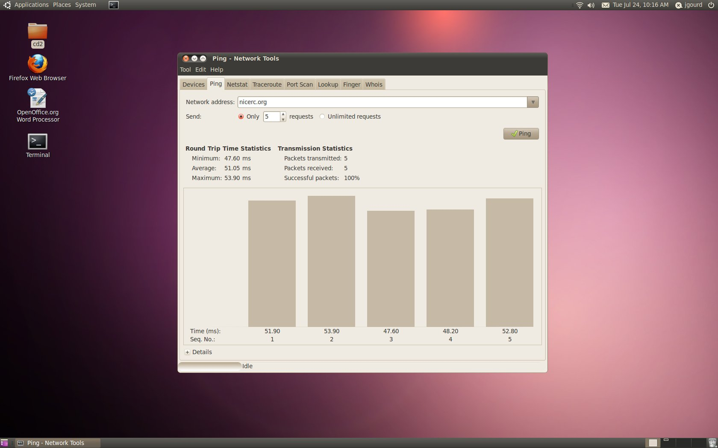
Ping

Slide 31
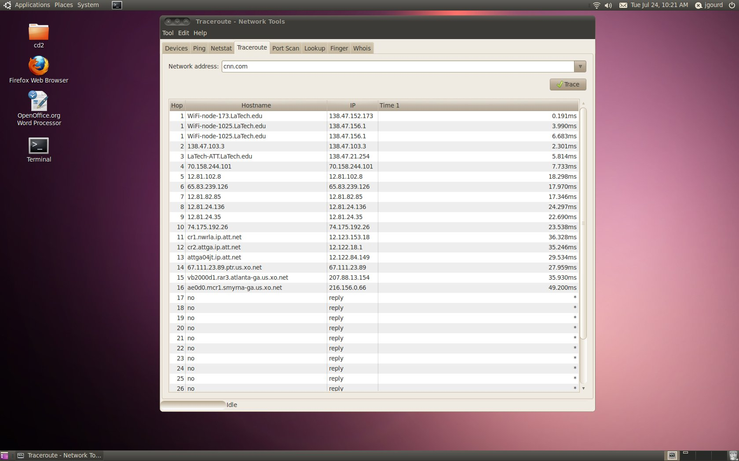
Traceroute

Slide 32
Security Issues
Discovering the message
  Sniffing
Changing the message
  Man-in-the-middle
  This includes intercepting or changing the message
Bombarding a service with useless requests
  Denial of service

Slide 33
More Fun with Strings

Slide 34
Sniffing
The tools we use to sniff are installed on the computer
Sample network traffic is located in the cd2 folder on the desktop
  sample.cap and sample2.cap
We access them via the terminal
The main tool is called “sniff”
  It must be run with root privileges (i.e., with “sudo”)

Slide 35
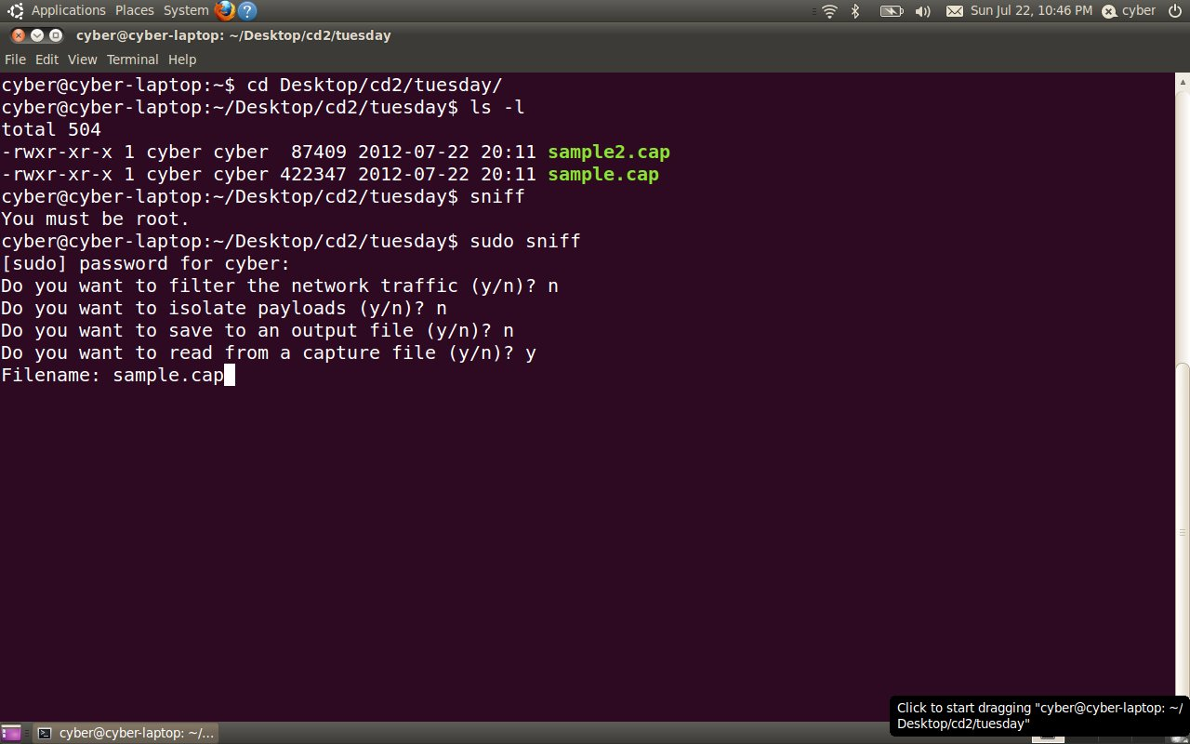
Sniffing

Slide 36
Sniffing
The capture file contained too much information for us to process
We need to filter this down to something more manageable
In our investigation, suppose we obtained a source IP address of 10.0.0.100
We could then filter the results to ignore everything else
  The filter: “src 10.0.0.100”

Slide 37
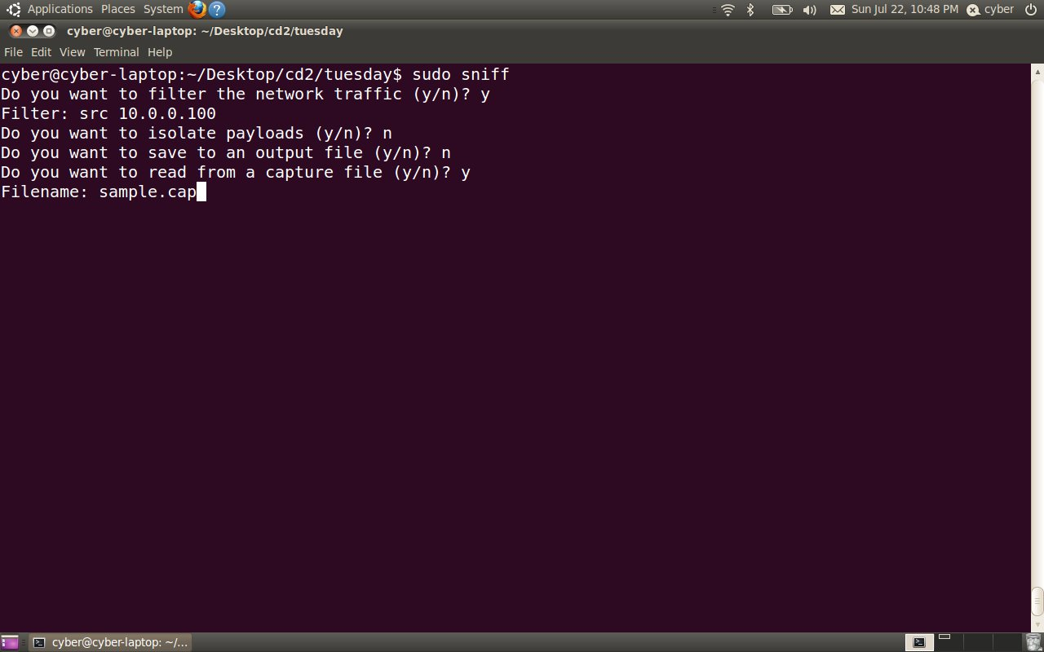
Sniffing

Slide 38
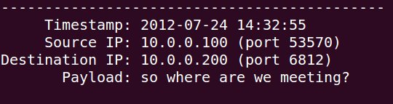
Sniffing
The results are much better
But they look like a one-way conversation
  We're missing the replies
Note that the destination IP address in each of these packets is 10.0.0.200
Let's try to filter just those now
  The filter: “src 10.0.0.200”

Slide 39

Sniffing

Slide 40
Sniffing
Again, this is a one-sided conversation
  The other side!
We can craft a filter that will give us both sides of the conversation
  We specify that the source IP address can either be 10.0.0.100 or 10.0.0.200
  The filter: “src 10.0.0.100 or src 10.0.0.200”

Slide 41
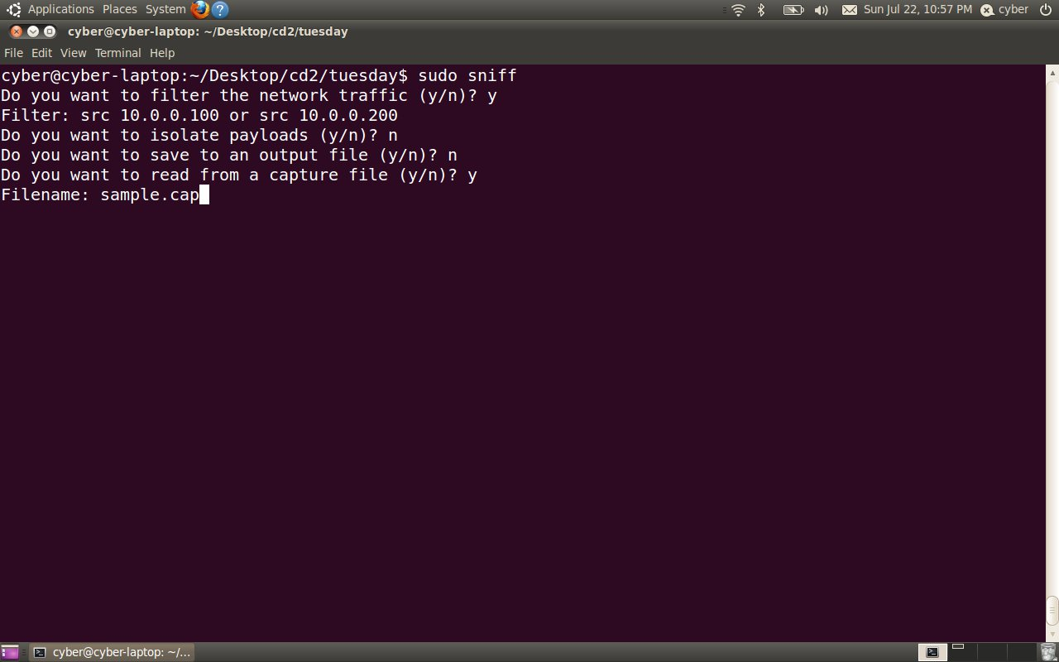
Sniffing

Slide 42
Sniffing
And we now have both sides of the chat!
hey
hi!
it's me
who?
Roger
Roger that, Roger! :D
hehe
what's the secret password?
secret
good
so where are we meeting?
the park
hrmm. which one?
same as usual
sounds good – what time?
midnight
ok cool – cya then
l8r

Slide 43
Extracting Payloads
Sometimes, we want to extract (and possibly merge) the payloads of multiple packets in a single message
For example, if we want to reconstruct the attachment of an email

Slide 44
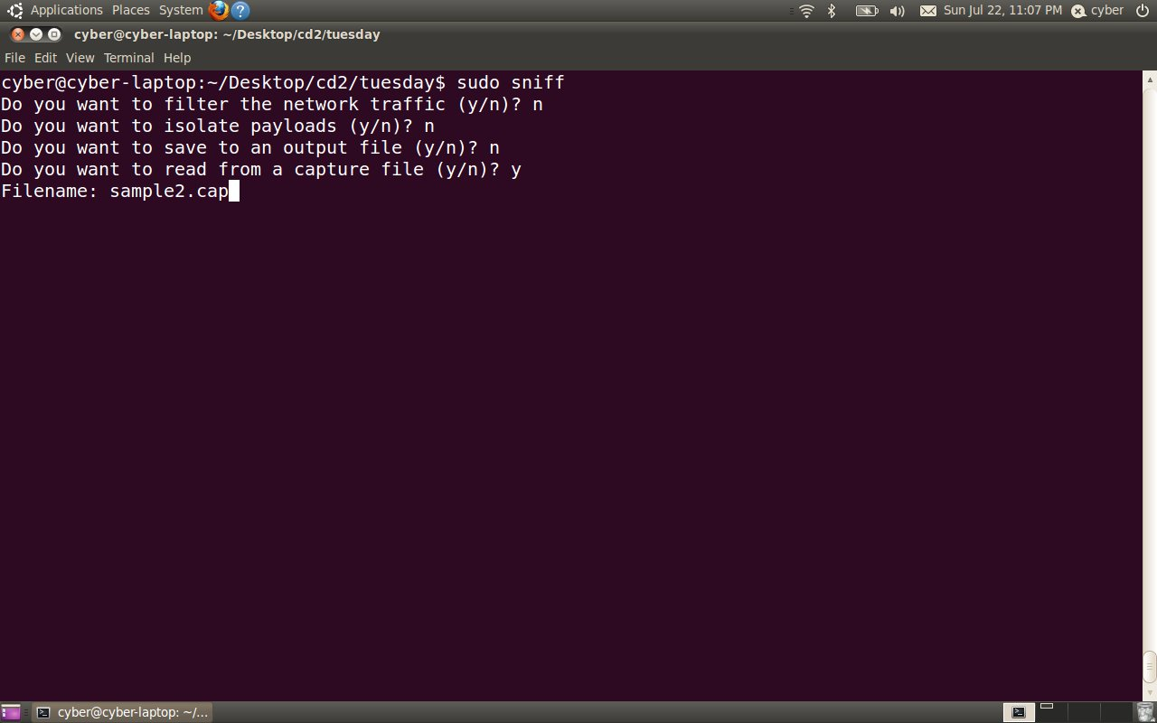
Extracting Payloads

Slide 45
Extracting Payloads
Again, there is too much information
  But every packet is part of a single message (from 10.0.0.100 to 10.0.0.200) and is therefore important
We can output the packets to a file that can be easily edited
If we do this in the “tuesday” folder, our payloads will be output there

Slide 46
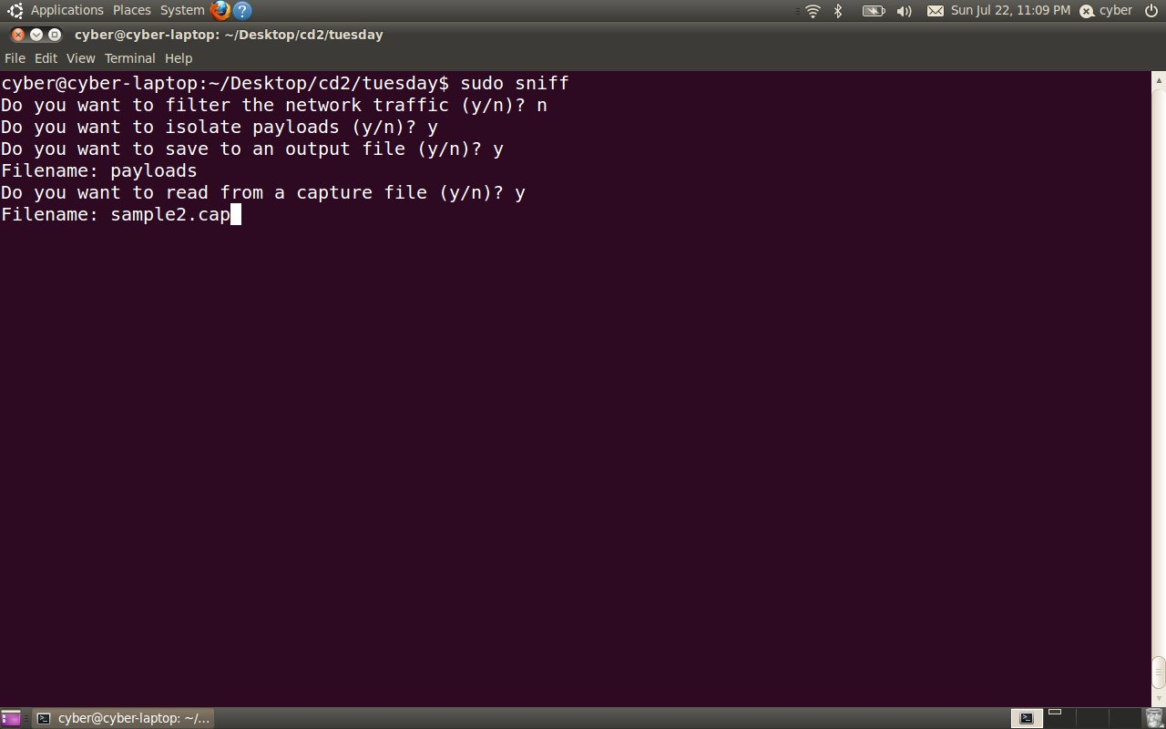
Extracting Payloads

Slide 47
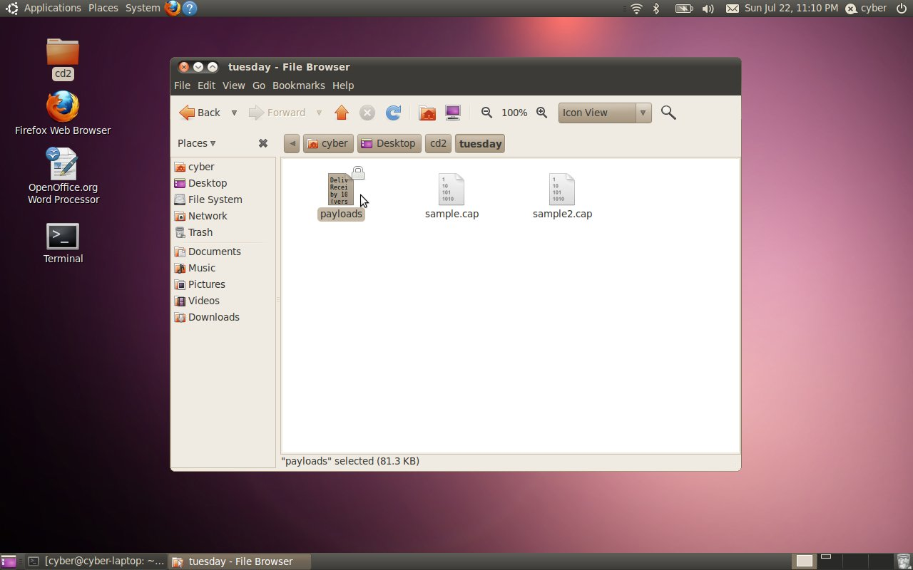
Extracting Payloads

Slide 48
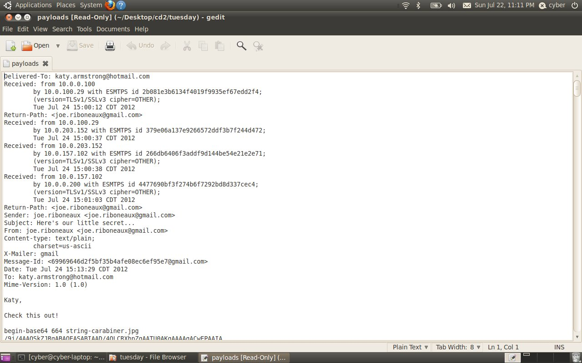
Extracting Payloads

Slide 49
Merging Payloads
We can merge the payloads into a single chunk and possibly convert it to the original attachment that the sender included in the email
In this case, the attachment was encoded in base64
Base64 is a scheme that encodes information in a format that can be transmitted over networks

Slide 50
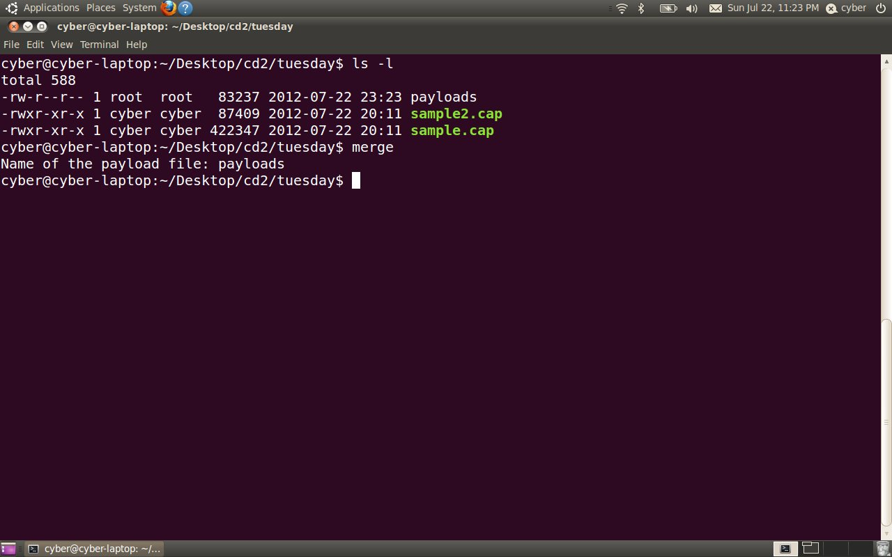
Merging Payloads

Slide 51
Merging Payloads
If successful, the merge creates a new file (the original attachment)
We can then see what kind of attachment it was by viewing the “tuesday” folder in the file explorer

Slide 52
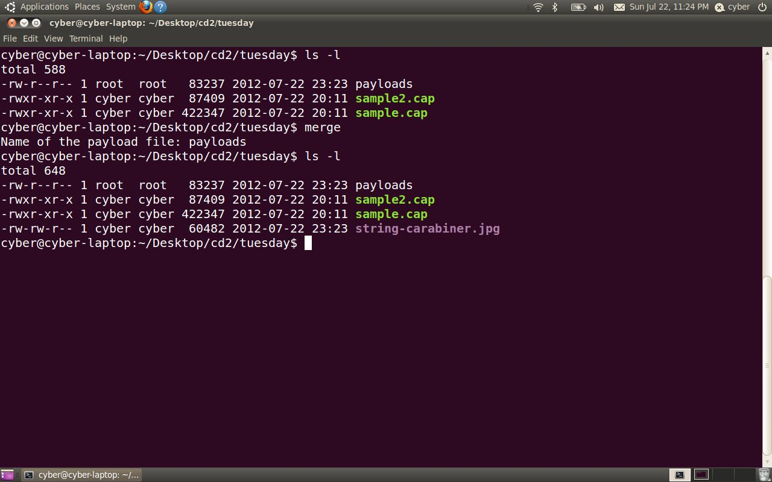
Merging Payloads

Slide 53
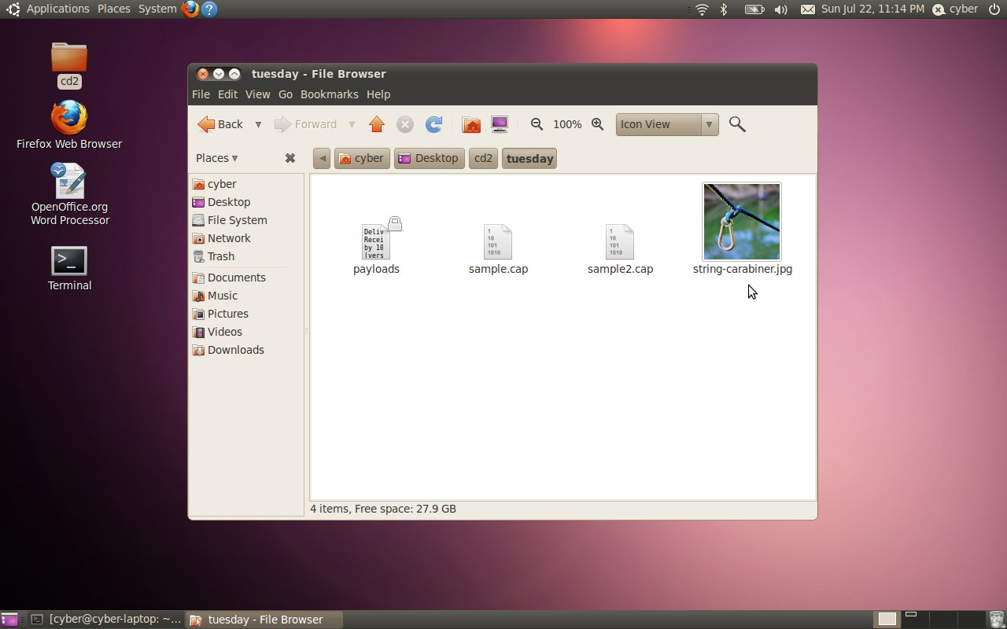
Merging Payloads

